Slide 1

Midterm Presentation
Project Conceptualization
Project Title: Develop games to improve reaction time
Group: João Génio 88771, Ruben Menino 89185
Practical assignment goal: Development of a VR application using a human-centered approach, specific devices and libraries.
RVA 2020-2021
Notes:
Genix -> 3 5 6 10 12 13
Ruben -> 1 2 4 7 8 9 11 14

Slide 2

Introduction
Develop games to improve reaction time
Virtual and Augmented Reality
VR
Athletes
Patients
Entertainment
Different mini games
Midterm Presentation - RVA 2020-2021
‹#›
Notes:
vr:
mais evoluido
mais leve, mais facil
atletas:
desportos que dependam
pacientes:
precisam de melhorar as suas capacidades físicas
entretenimento

Slide 3
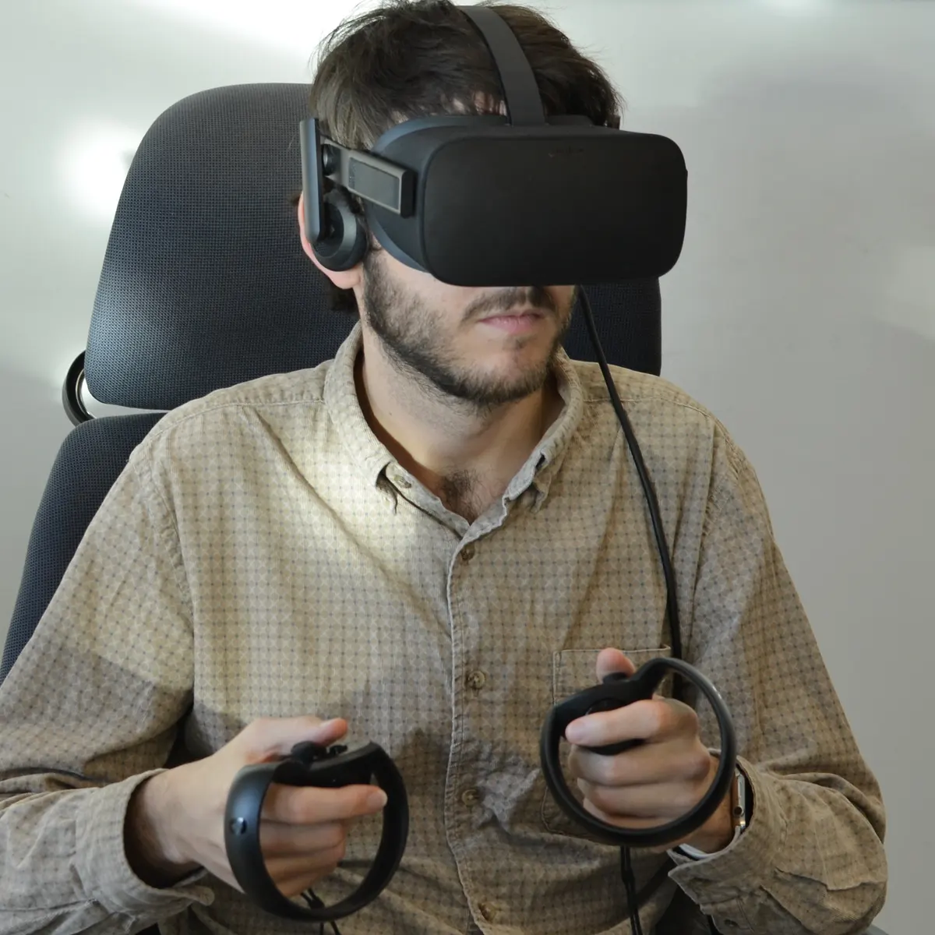
Project Vision
Develop games to improve reaction time
Providing a tool that mainly focuses on improving physical dexterity but can also provide entertainment.
Box of mini games based on reaction time.
Goal Areas:
Athletes
Patients
Entertainment
VR in the future:
mainstream
convenient
Midterm Presentation - RVA 2020-2021
‹#›

Slide 4

Project Objectives
Develop games to improve reaction time
Get at least three minigames ready to be used by different people who need for some reason to improve their reaction time, or just for fun.
Several benefits:
Mental dexterity
Improvement at different levels:
gaming
sports
etc…
Midterm Presentation - RVA 2020-2021
‹#›

Slide 5
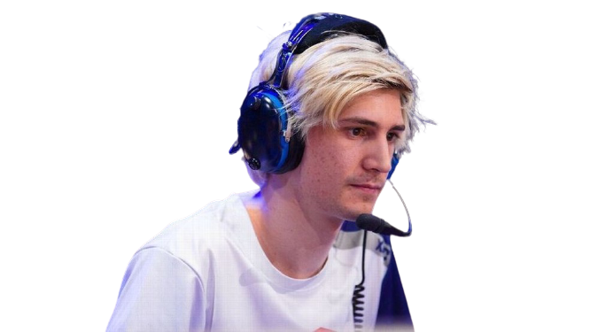
Personas
Develop games to improve reaction time
Américo Fernandes
26 years old.
Student, Table tennis player, Gamer.
Engineering student who embraces the world of gaming.
He enjoys various sports such as table tennis, martial arts and boxing.
Some experience with VR.
Wants to improve his reactions in the world of virtual games.
Midterm Presentation - RVA 2020-2021
‹#›

Slide 6

Personas
Develop games to improve reaction time
Jéssica Marlene
72 years old.
Patient, Crochet enthusiast.
Was involved in a car accident and had her attention and dexterity decreased.
No previous experience with VR.
Wants an easy-to-use tool that can help her rehab but also have fun doing it.
Midterm Presentation - RVA 2020-2021
‹#›

Slide 7
User Stories
Develop games to improve reaction time
Develop games to improve reaction time
As a user (Américo), I want to improve my reactions by touching the correct buttons as fast as I can.
As a user (Jéssica), I want to start the game whenever I want.
Midterm Presentation - RVA 2020-2021
‹#›

Slide 8
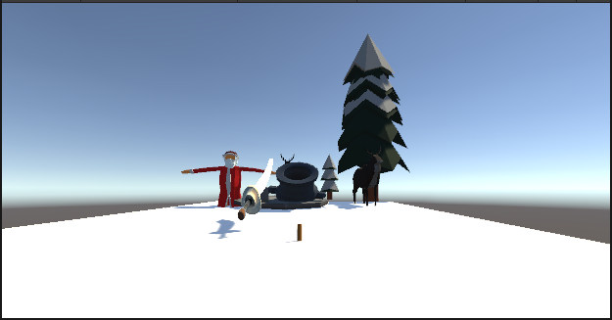
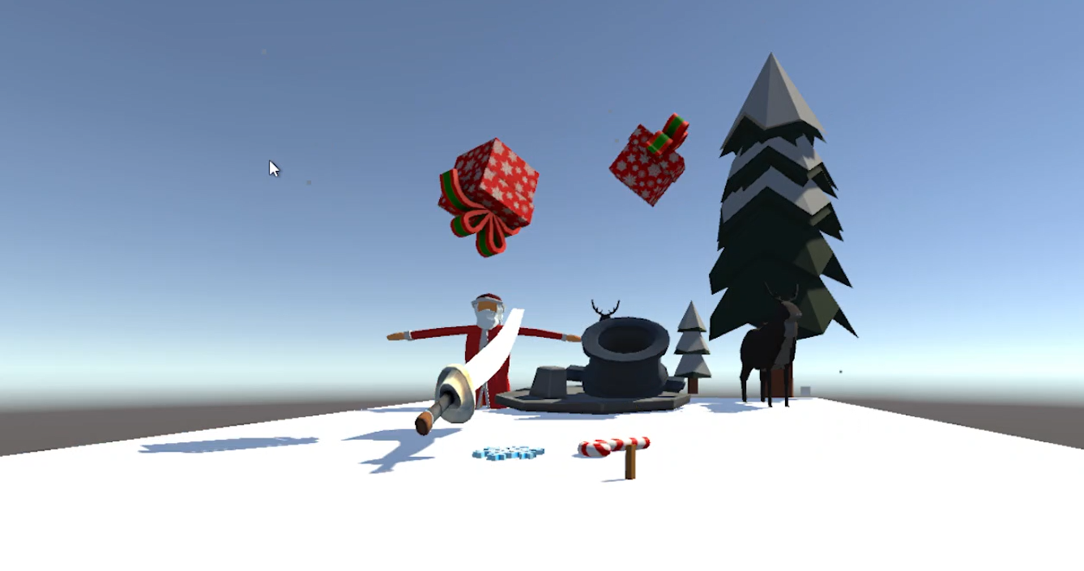

Storyboards
Develop games to improve reaction time
Button (start game) -> Hit object -> Score points
Midterm Presentation - RVA 2020-2021
‹#›

Slide 9
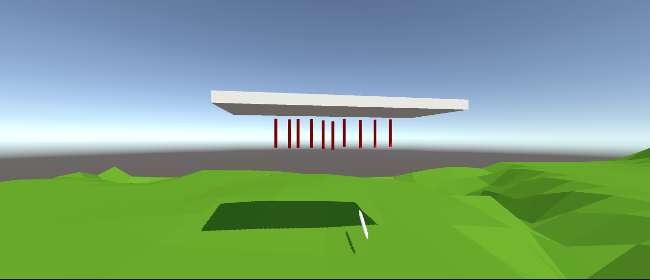
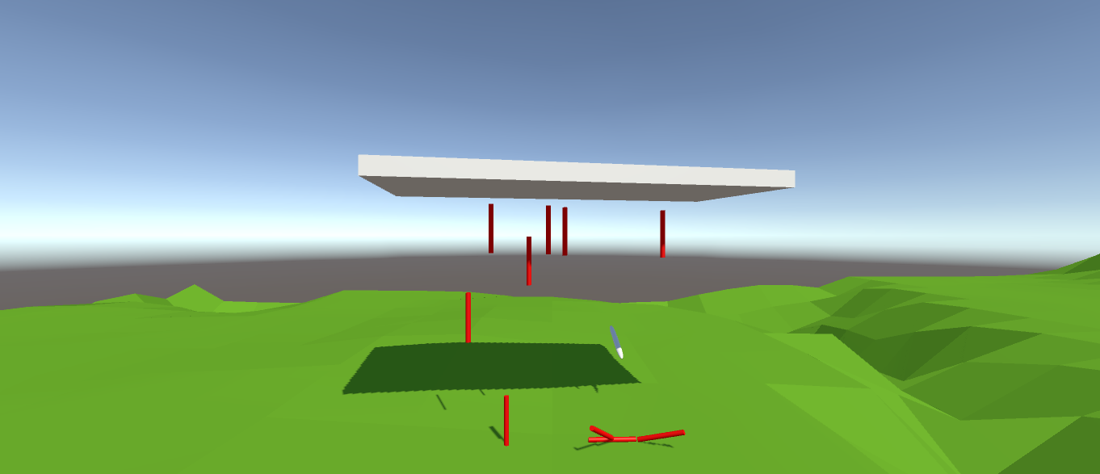
Storyboards
Develop games to improve reaction time
Wait for object to fall -> Grab that object -> Score points
Midterm Presentation - RVA 2020-2021
‹#›

Slide 10
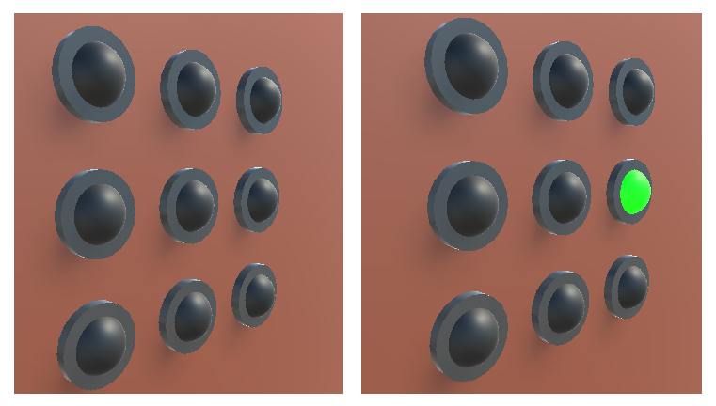
Storyboards
Develop games to improve reaction time
Light comes on -> Press the lit button -> Wait for next light
Midterm Presentation - RVA 2020-2021
‹#›

Slide 11

Requirements
Develop games to improve reaction time
Quality requirements - Usability, reliability, testability
Functional Requirements - how to play the game, start game, score, highscore…
Midterm Presentation - RVA 2020-2021
‹#›

Slide 12

Project Constraints
Develop games to improve reaction time
Random game sequence but fair
Difficulty needs to be a setting
Separate statistics by difficulty
Goals that are easy to understand
Simple hand movements
Overall ease of use from the get-go
Midterm Presentation - RVA 2020-2021
‹#›

Slide 13
Project Situation
Develop games to improve reaction time
Air Slash Game
Random objects are launched from different positions
Destruction after collision with the “player’s hand/sword”
Score
Highscore
Falling Sticks
Suspended sticks fall in random order with equal time difference
Player has to catch each one of them before they hit the ground
Button Game
Button can light up in one of 2 colors:
- Green: Player should press it
- Red: Player should not press it
Score based on reaction time
Game ends if red button is pressed
Midterm Presentation - RVA 2020-2021
‹#›

Slide 14
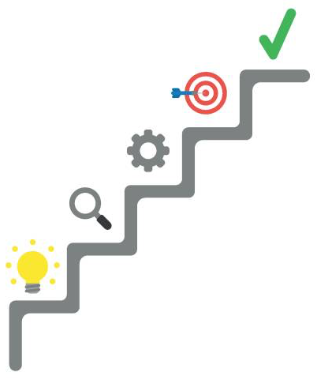
Next Steps
Develop games to improve reaction time
Start Menu
Instructions - How to play
Difficulty Settings
Statistics Page
Implement and test the VR interaction modules
Visual and Audio improvements
Development of more games
Midterm Presentation - RVA 2020-2021
‹#›

